Slide 1
HATE SPEECH CLASSIFIER
GROUP-A

Slide 2
Brief Overview
Social Media has become an essential part of our daily lives with over 3 billion active users currently active.
Twitter has over 319 million users with over 500 million tweets being exchanged every single day
Twitter limits each tweet to 140 characters which has been since doubled in various languages
Primarily, our dataset classifies tweets into hate speech, offensive language or neither of those

Slide 3
Brief Overview
33% of American Teens use Twitter while nearly 43% of kids have been bullied online on various platforms
One of every four has been bullied more than once
Various platforms have also been accused of promoting political propaganda emphasising the power of social media

Slide 4
Impact of Social Media
Internet and communication has rapidly changed over the last 20 years. We have benefitted from this change while there have been some who have used this privilege to abuse and bully others.
It has impacted various business spheres and has led to the rise of various fields such as “Digital Marketing” and has become a great platform for start-ups and smaller organisation
This has led to various issues too with one being cyber bullying.
Social media has also weakened face to face interaction and has caused certain strangers to turn into threats.

Slide 5
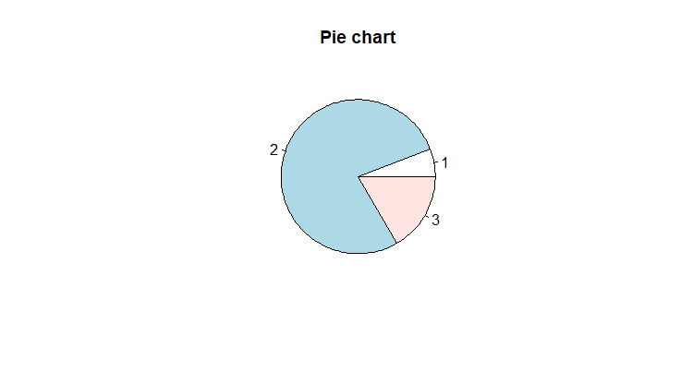
Our dataset
Our dataset has been taken from www.Kaggle.com and consists of 24,000 tweets with the first column being the ground truth assigning 0 to hate speech, 1 to offensive speech and 2 as neither.

Slide 6
Data Preparation
Punctuations and special characters are removed while all alphabets are converted to lowercase
Symbols such as RT will be removed too to reduce size of the input tweet
Irrelevant details such as website links could we normalized to a simple symbol such as URL
Example:
Raw: misses Swimming Class. http://plurk.com/p/12nt0b
Normalized: misses swimming class URL

Slide 7
Decision Tree Classification
A decision tree is a flowchart-like structure for classification that considers all possible consequences
We considered the ‘Gini’ index as a measure of impurity while splitting
Trees may be simplified by pruning which is to end the tree at a certain depth
It can take different data types as input for classification (continuous, categorical, numerical)

Slide 8
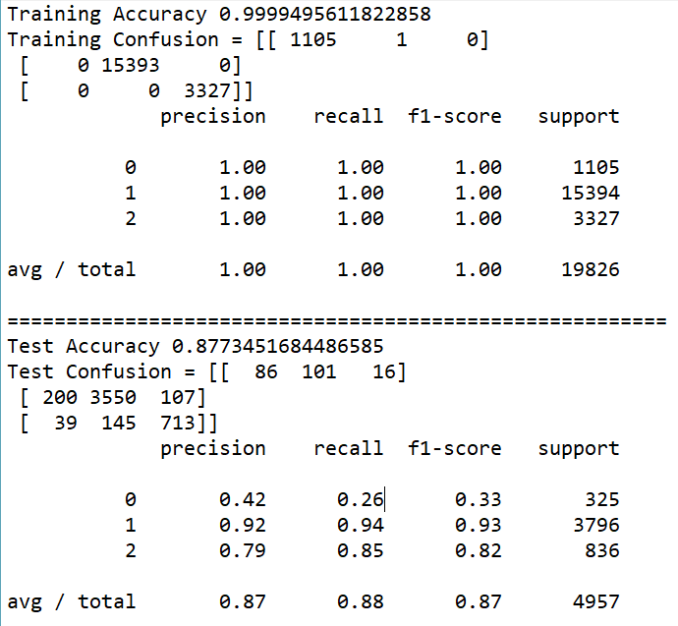
Accuracy

Slide 9
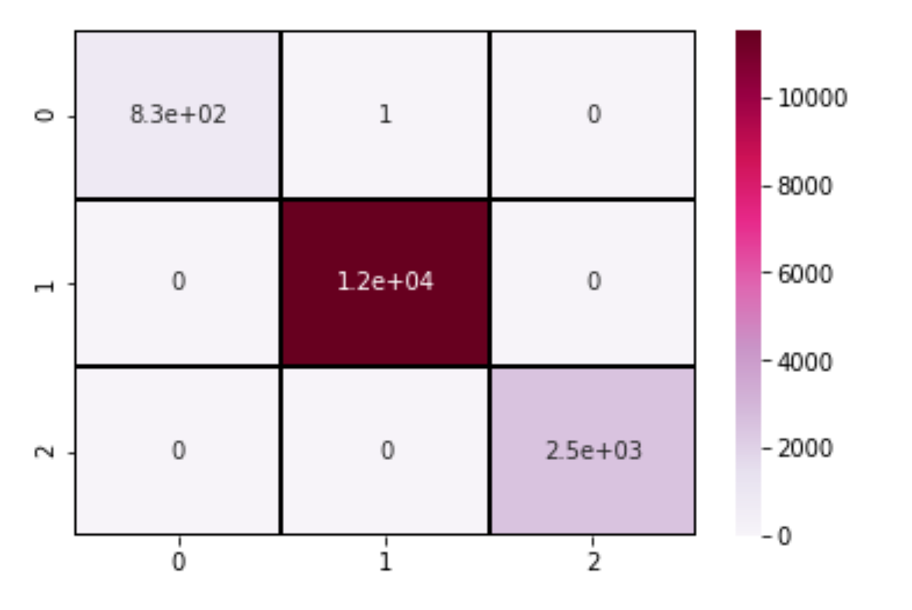
Decision Tree Training

Slide 10
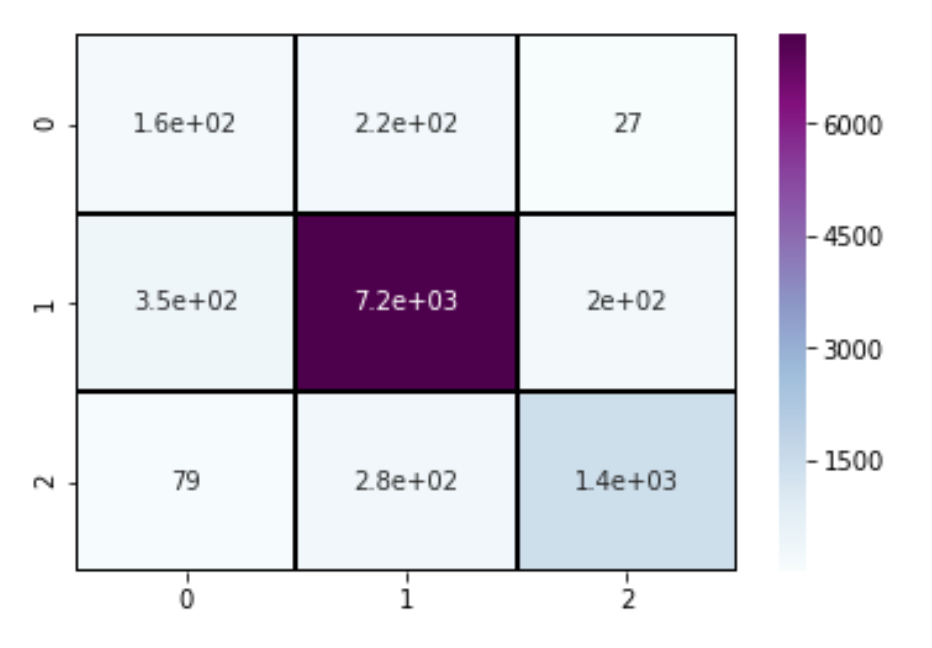
Decision Tree Testing

Slide 11
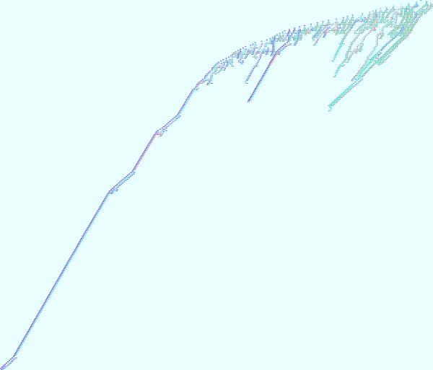
Overclassified Decision Tree

Slide 12
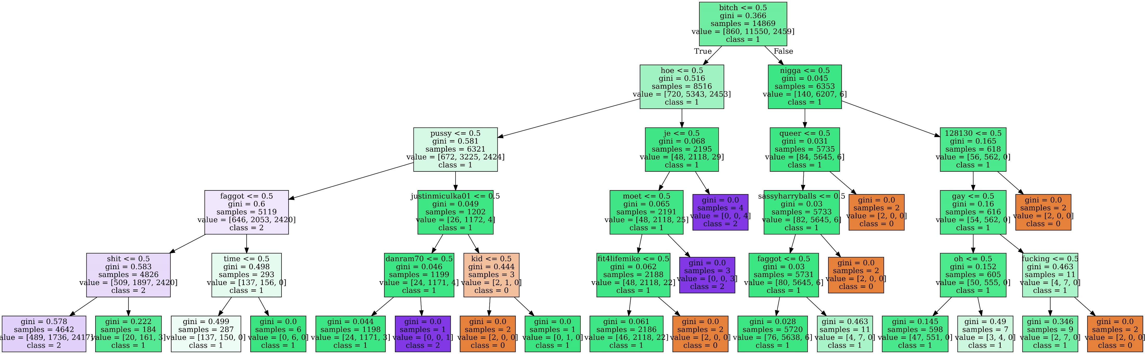

Slide 13
Random Forest Classification
Random forest are an easy to use machine learning algorithm that produces, even without hyper-parameter tuning, a great result most of the time
It is widely used as it is simple and can be applied to both classification and regression tasks
Random forest builds multiple decision trees and merges them together to make a more accurate and stable prediction
It is a supervised learning algorithm

Slide 14
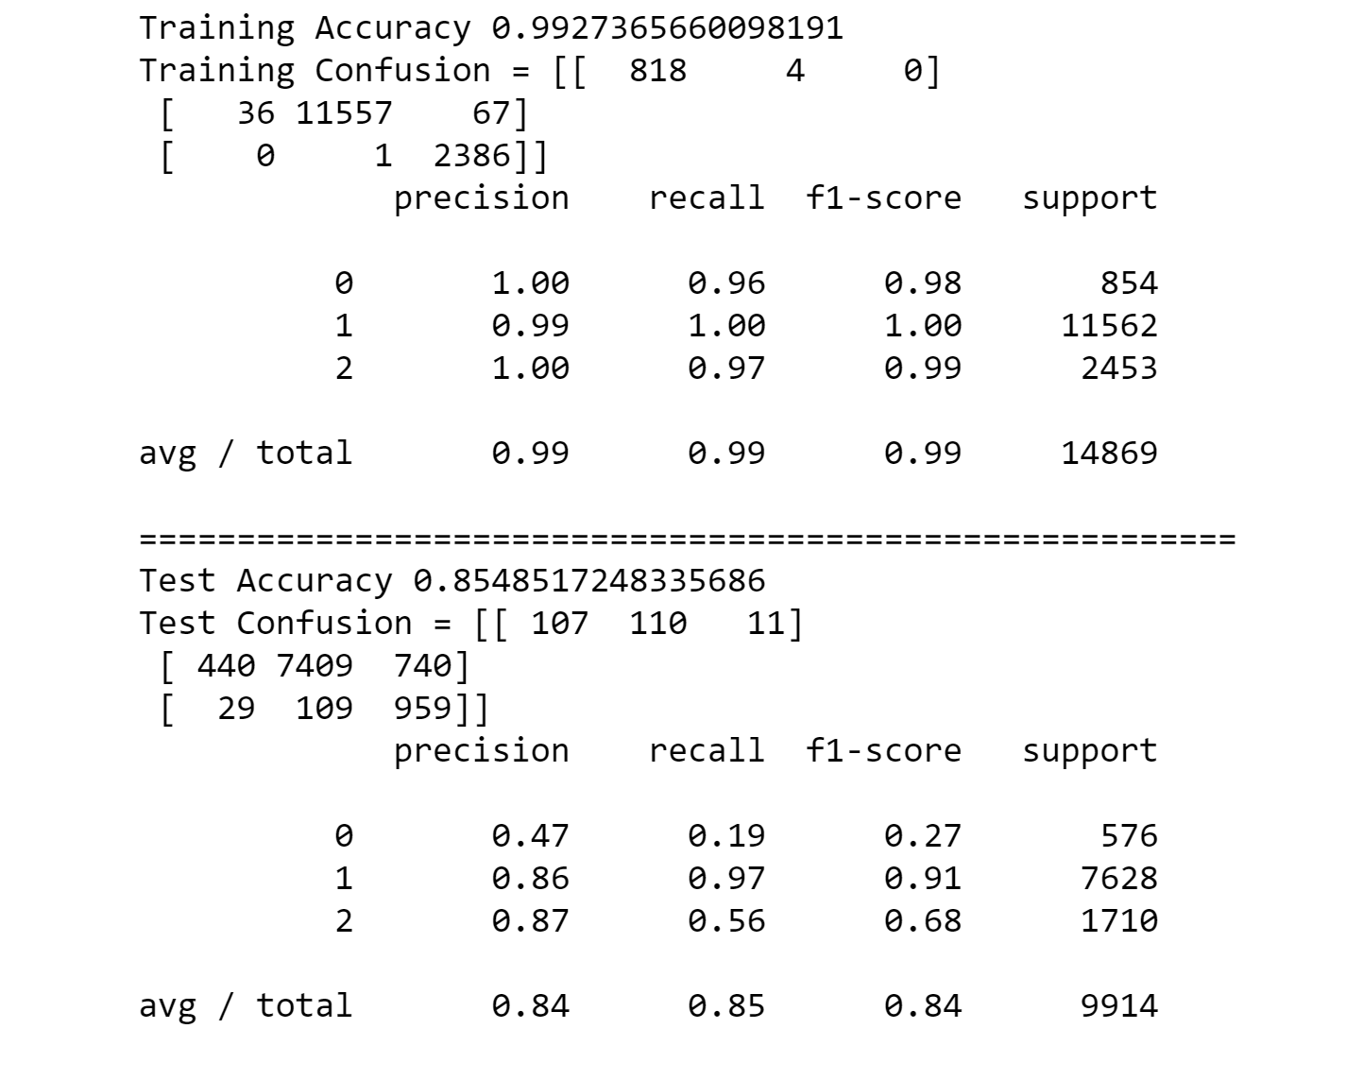
Accuracy

Slide 15
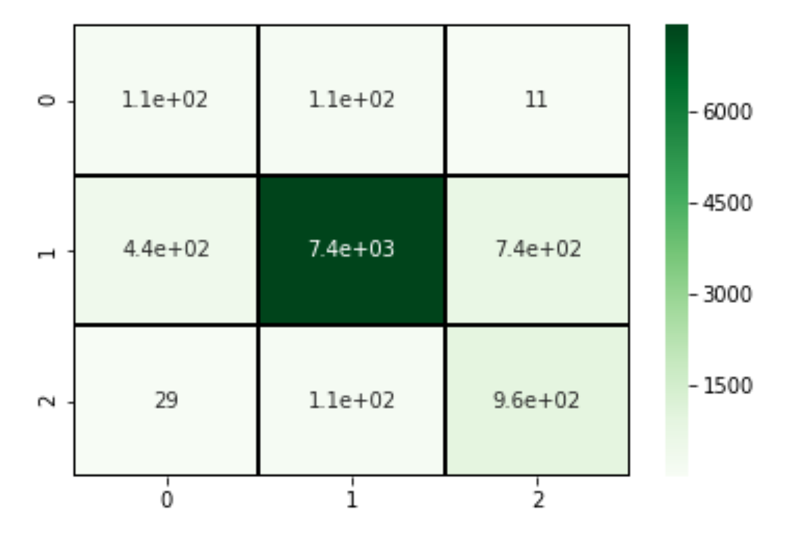
Random Forest Test Confusion Matrix

Slide 16
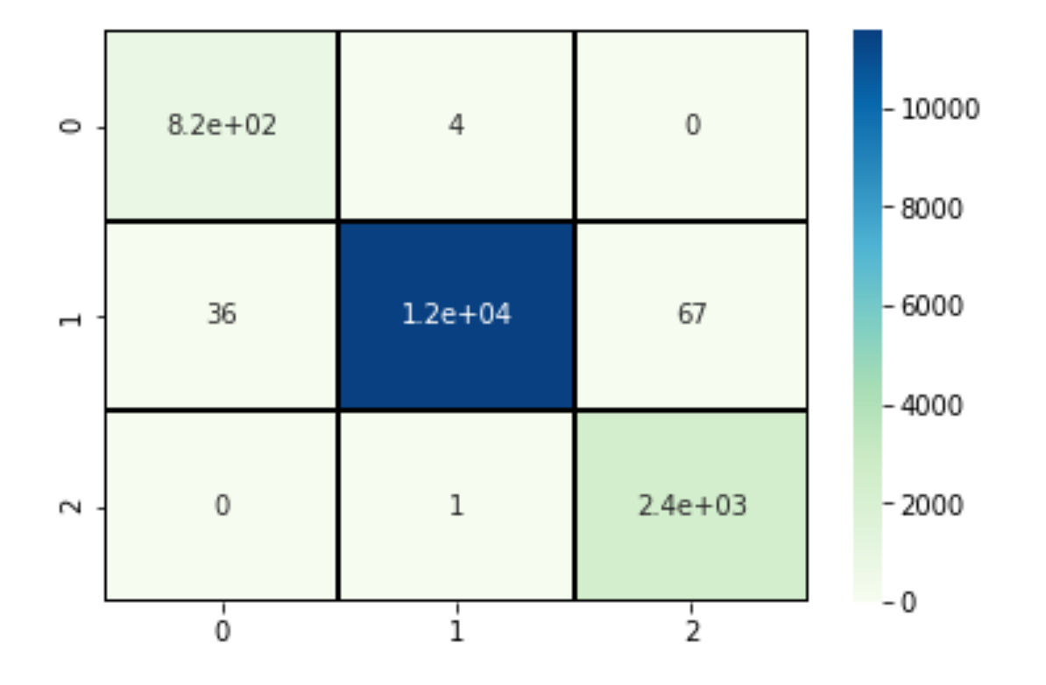
Random Forest Train Confusion Matrix

Slide 17
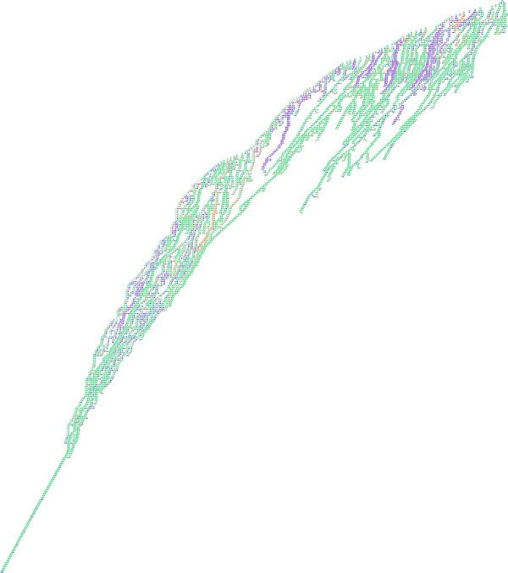
Overclassified Random Forest Tree

Slide 18
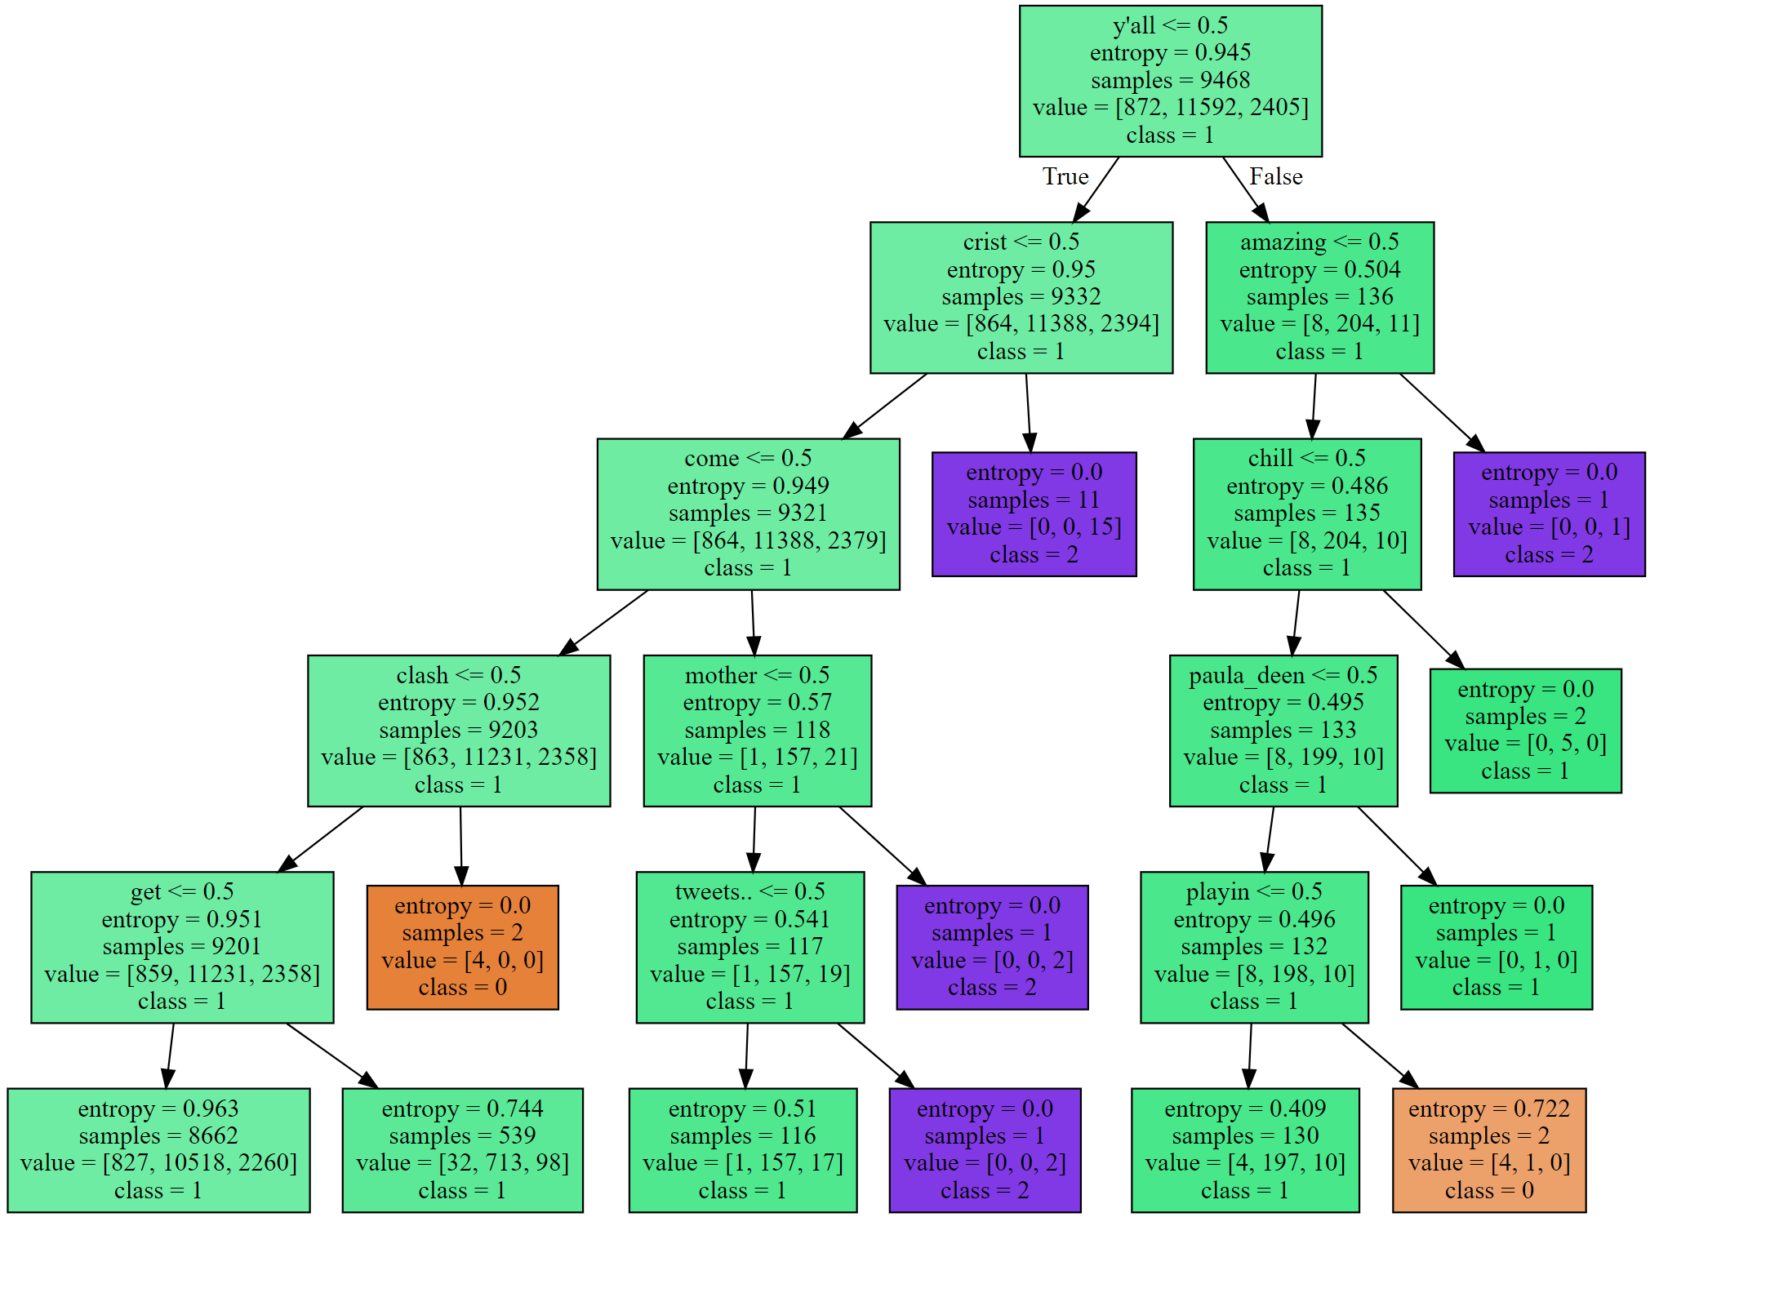

Slide 19
Support Vector Machine Classifier
A SVM creates a hyperplane or set of hyperplanes which can be used for classification, regression, or other tasks like identifying outliers.
We plot each data item as a point in n-dimensional plane where we perform classification by finding a hyperplane to differentiate them
It works well with clear margin of separation and is effective in high dimensional space

Slide 20
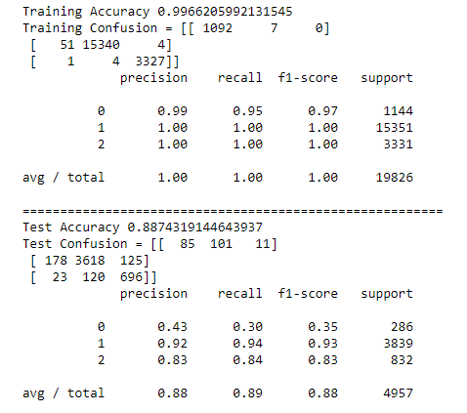
Accuracy

Slide 21
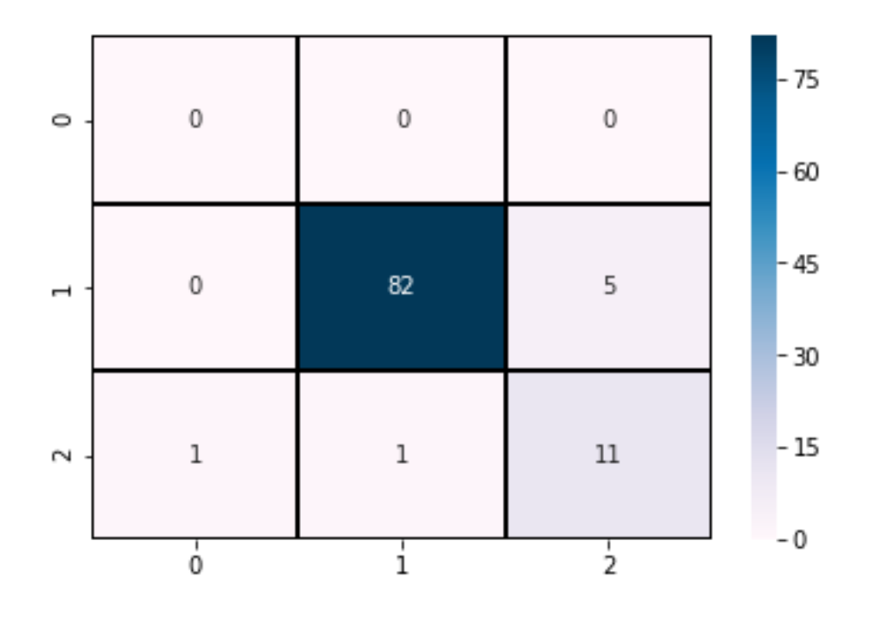
Sampled SVM Testing Confusion Matrix

Slide 22
Logistic Regression
Logistic regression is the appropriate analysis to conduct when the dependant variable is binary or categorical.
We define the logit(p) function which is the log odds of an event.
We calculate the required parameters and put X as the predictor value.
Ln($\frac{P}{1−P}$)=$B_{o}$+$B_{1}X_{1}$+……..+$B_{k}X_{k}$
Ln(𝑃/(1−𝑃))=𝐵_𝑜+𝐵_1 𝑋_1+……..+𝐵_𝑘 𝑋_𝑘

Slide 23
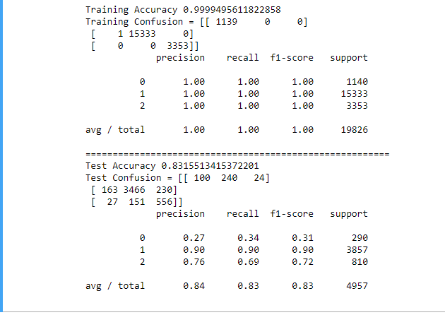
Accuracy

Slide 24
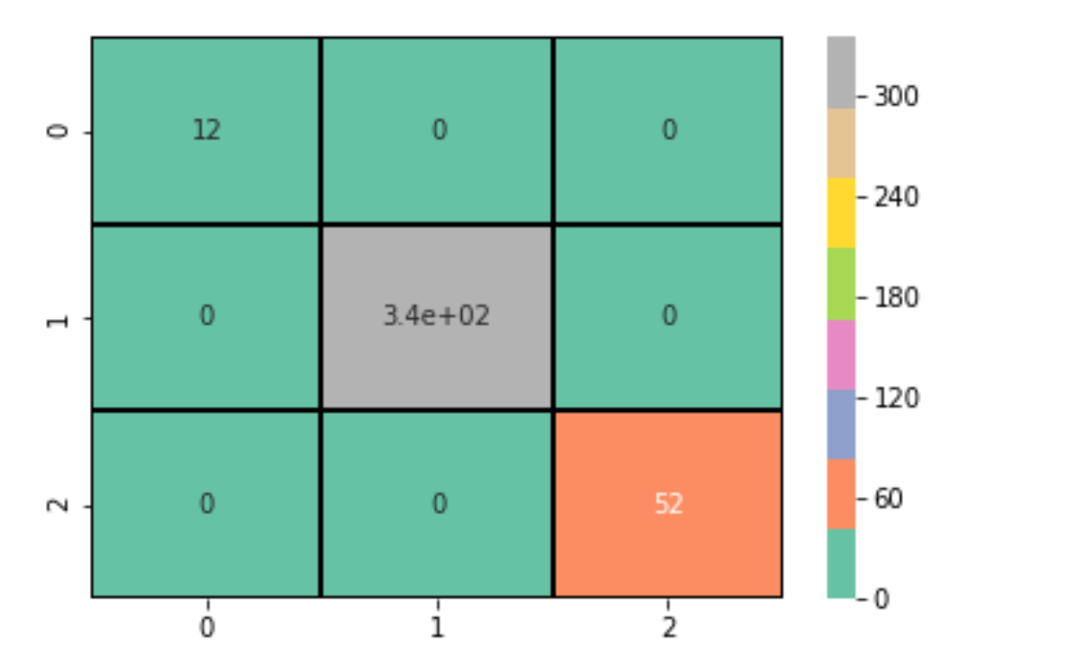
Logistic Regression Training Data

Slide 25
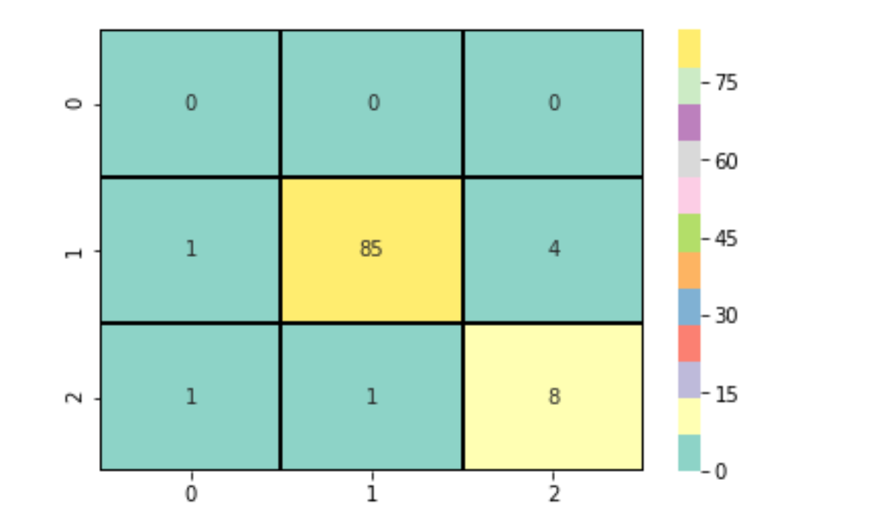
Logistic Regression Test Data

Slide 26
K-nearest neighbour classification(KNN)
K-nearest neighbour is a non-parametric method used for classification and regression
KNN does not use any data points to do any generalization or, the training phase is minimal
KNN Algorithm is based on feature similarity and can be used for categorical classification such as credit rating, hand writing detection etc

Slide 27
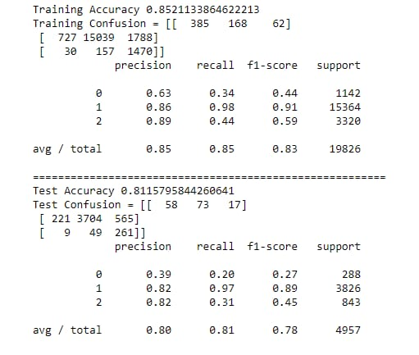
Accuracy

Slide 28
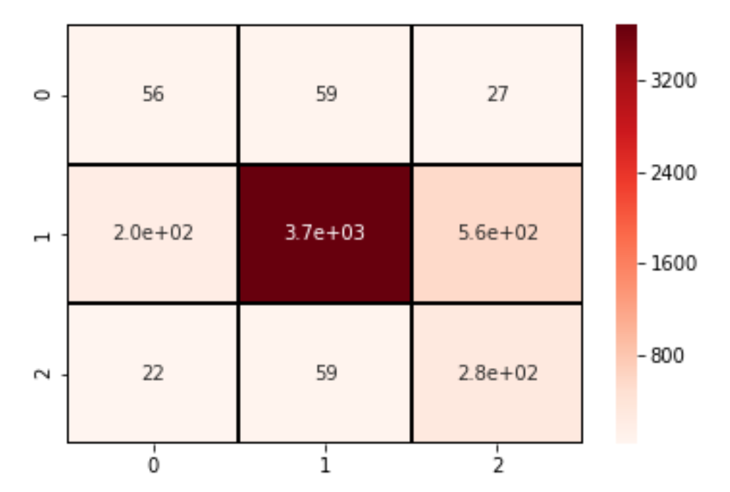
KNN Testing Data

Slide 29
Naïve Bayes Classifier
It is a probabilistic classifier that makes classifications using the Maximum A Posteriori decision rule in a Bayesian setting
Naive Bayes classifiers have been especially popular for text classification, and are a traditional solution for problems such as spam detection.
It is based on Bayes rule of conditional probability:
P(A|B)=P(B|A)P(A)/P(B)

Slide 30
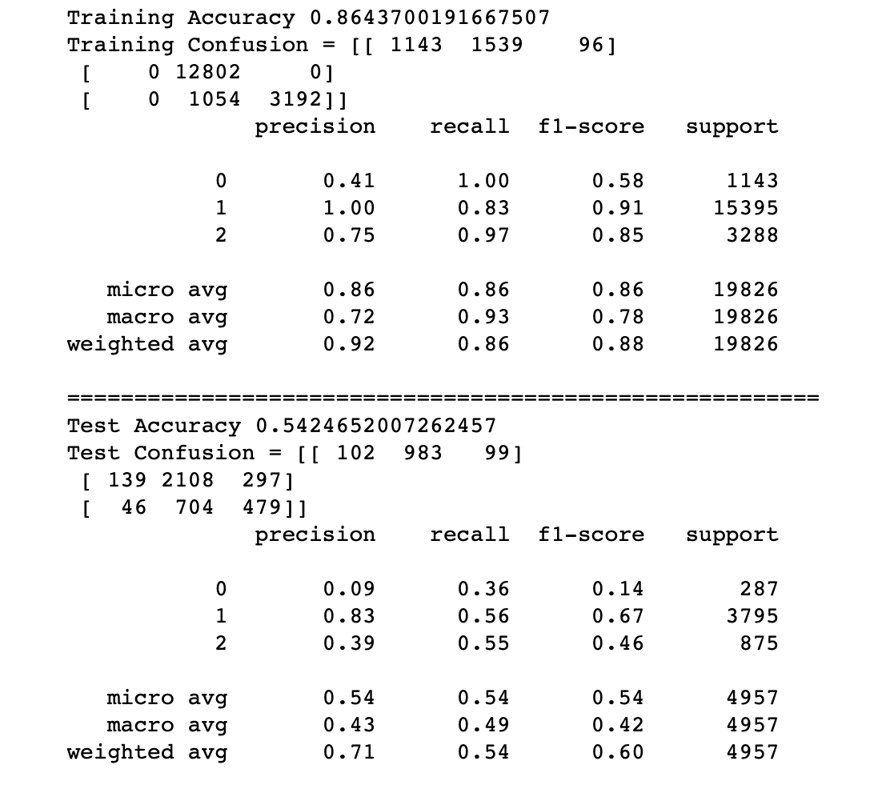
Accuracy

Slide 31
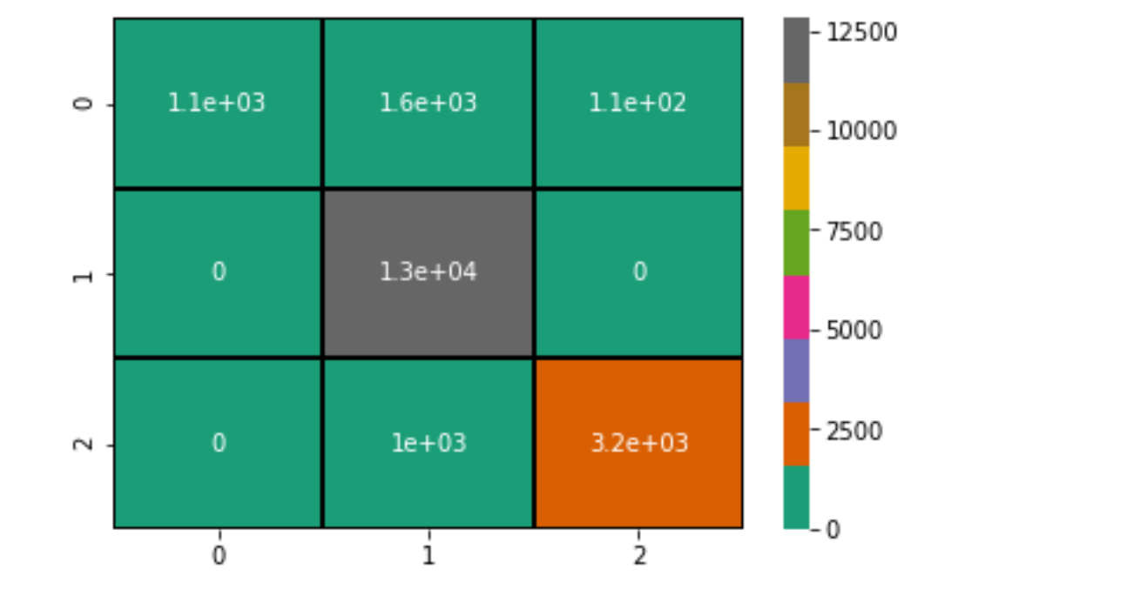
Naïve Bayes Training Data

Slide 32
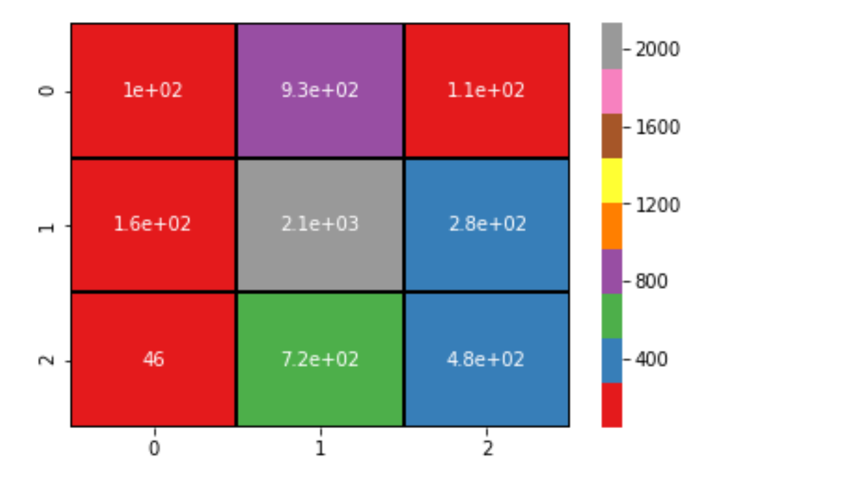
Naïve Bayes Test Data

Slide 33
Comparing Accuracy

Slide 34

Conclusion
From our huge dataset, it is clear that hate speech and offensive text can be accurately filtered out using various classification algorithms
Internet is a huge platform and for most of us is no longer a luxury to have and now a necessity
We all must act as responsible ‘netizens’ and refrain from misusing the internet
Twitter has a reach of billions thus must be used carefully
6.6% boys and 6.7% girls between age 12 and 18 have been targets of hate speech on the basis of race, ethnicity, religion, and disability.

Slide 35
THANK YOU
BY:
APOORVA SINHA
KSHITIJ AHUJA
ABHISHEK CHANDER
AMNAYA PRADHAN
ASIM JAMAL
LEKHA K

